Slide 1
Support Vector Machine (SVM) Algorithm & K-Nearest Neighbor (KNN) Algorithm

Slide 2
Support Vector Machine (SVM) Algorithm
A Support Vector Machine (SVM) is a supervised machine learning algorithm used for both classification and regression tasks.
While it can be applied to regression problems, SVM is best suited for classification tasks.
The primary objective of the SVM algorithm is to identify the optimal hyperplane in an N-dimensional space that can effectively separate data points into different classes in the feature space.
The algorithm ensures that the margin between the closest points of different classes, known as support vectors, is maximized.

Slide 3
The dimension of the hyperplane depends on the number of features. For instance, if there are two input features, the hyperplane is simply a line, and if there are three input features, the hyperplane becomes a 2-D plane. As the number of features increases beyond three, the complexity of visualizing the hyperplane also increases.

Slide 4
Consider two independent variables, x1 and x2, and one dependent variable represented as either a blue circle or a red circle.
In this scenario, the hyperplane is a line because we are working with two features (x1 and x2).
There are multiple lines (or hyperplanes) that can separate the data points.
The challenge is to determine the best hyperplane that maximizes the separation margin between the red and blue circles.

Slide 5
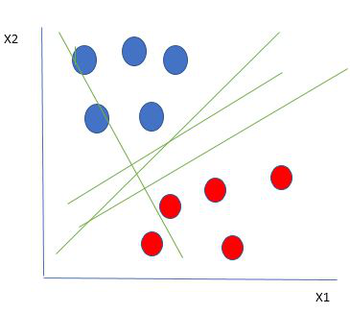

Slide 6
How does Support Vector Machine Algorithm Work?
One reasonable choice for the best hyperplane in a Support Vector Machine (SVM) is the one that maximizes the separation margin between the two classes.
The maximum-margin hyperplane, also referred to as the hard margin, is selected based on maximizing the distance between the hyperplane and the nearest data point on each side.

Slide 7
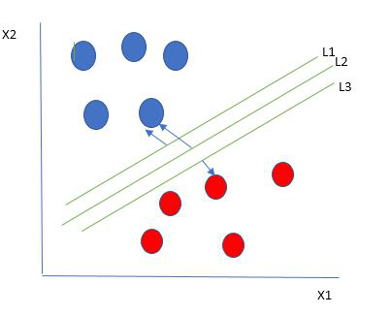
So we choose the hyperplane whose distance from it to the nearest data point on each side is maximized.
If such a hyperplane exists it is known as the maximum-margin hyperplane/hard margin. So from the above figure, we choose L2.

Slide 8
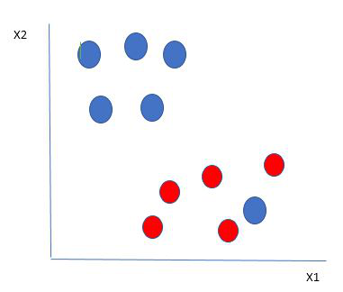
Let’s consider a scenario like shown below.
Here we have one blue ball in the boundary of the red ball. So how does SVM classify the data? It’s simple! The blue ball in the boundary of red ones is an outlier of blue balls.
The SVM algorithm has the characteristics to ignore the outlier and finds the best hyperplane that maximizes the margin. SVM is robust to outliers.

Slide 9
So in this type of data point what SVM does is, finds the maximum margin as done with previous data sets along with that it adds a penalty each time a point crosses the margin. So the margins in these types of cases are called soft margins.

Slide 10
K-Nearest Neighbor(KNN) Algorithm
KNN is one of the most basic yet essential classification algorithms in machine learning. It belongs to the supervised learning domain and finds intense application in pattern recognition, data mining, and intrusion detection.
It is widely disposable in real-life scenarios since it is non-parametric, meaning it does not make any underlying assumptions about the distribution of data (as opposed to other algorithms such as GMM, which assume a Gaussian distribution of the given data). We are given some prior data (also called training data), which classifies coordinates into groups identified by an attribute.

Slide 11
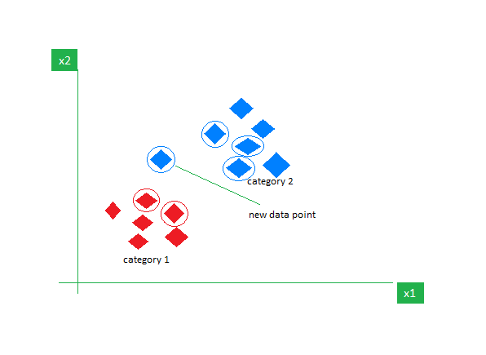
As an example, consider the following table of data points containing two features:
Now, given another set of data points (also called testing data), allocate these points to a group by analyzing the training set. Note that the unclassified points are marked as ‘White’.

Slide 12
Intuition Behind KNN Algorithm
If we plot these points on a graph, we may be able to locate some clusters or groups. Now, given an unclassified point, we can assign it to a group by observing what group its nearest neighbors belong to. This means a point close to a cluster of points classified as ‘Red’ has a higher probability of getting classified as ‘Red’.

Slide 13
The K-NN algorithm works by finding the K nearest neighbors to a given data point based on a distance metric, such as Euclidean distance. The class or value of the data point is then determined by the majority vote or average of the K neighbors. This approach allows the algorithm to adapt to different patterns and make predictions based on the local structure of the data.

Slide 14
Distance Metrics Used in KNN Algorithm
As we know that the KNN algorithm helps us identify the nearest points or the groups for a query point. But to determine the closest groups or the nearest points for a query point we need some metric. For this purpose, we use below distance metrics:

Slide 15

Euclidean Distance
This is nothing but the cartesian distance between the two points which are in the plane/hyperplane. Euclidean distance can also be visualized as the length of the straight line that joins the two points which are into consideration. This metric helps us calculate the net displacement done between the two states of an object.

Slide 16

Manhattan Distance
Manhattan Distance metric is generally used when we are interested in the total distance traveled by the object instead of the displacement. This metric is calculated by summing the absolute difference between the coordinates of the points in n-dimensions.

Slide 17
How to choose the value of k for KNN Algorithm?
The value of k is very crucial in the KNN algorithm to define the number of neighbors in the algorithm. The value of k in the k-nearest neighbors (k-NN) algorithm should be chosen based on the input data. If the input data has more outliers or noise, a higher value of k would be better. It is recommended to choose an odd value for k to avoid ties in classification. Cross-validation methods can help in selecting the best k value for the given dataset.

Slide 18
Algorithm for K-NN
Distance To NN =sort(distance from 1st example, distance from k^{th} example)
value i=1 to number of training records:
Dist=distance(test example, i^{th} example)
if (Dist<any example in Distance To NN):
Remove the example from Distance To NN and value.
Put new example in Distance To NN and value in sorted order.
Return average of value
Fit using K-NN is more reasonable than 1-NN, K-NN affects very less from noise if dataset is large.

Slide 19
Workings of KNN algorithm
Thе K-Nearest Neighbors (KNN) algorithm operates on the principle of similarity, where it predicts the label or value of a new data point by considering the labels or values of its K nearest neighbors in the training dataset.

Slide 20
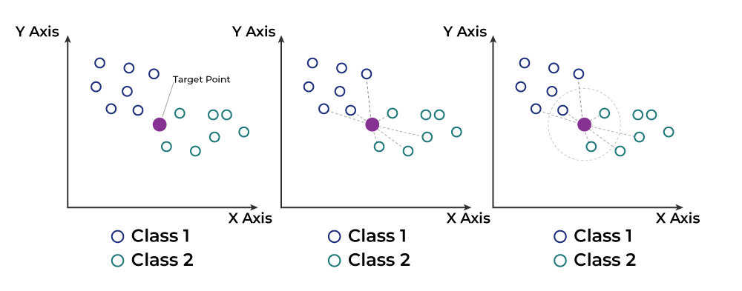

Slide 21
Step-by-Step explanation of how KNN works is discussed below:
Step 1: Selecting the optimal value of K
K represents the number of nearest neighbors that needs to be considered while making prediction.
Step 2: Calculating distance
To measure the similarity between target and training data points, Euclidean distance is used. Distance is calculated between each of the data points in the dataset and target point.
Step 3: Finding Nearest Neighbors
The k data points with the smallest distances to the target point are the nearest neighbors.

Slide 22
Step 4: Voting for Classification or Taking Average for Regression
In the classification problem, the class labels of K-nearest neighbors are determined by performing majority voting. The class with the most occurrences among the neighbors becomes the predicted class for the target data point.
In the regression problem, the class label is calculated by taking average of the target values of K nearest neighbors. The calculated average value becomes the predicted output for the target data point.

Slide 23
Let X be the training dataset with n data points, where each data point is represented by a d-dimensional feature vector X_{i​} and Y be the corresponding labels or values for each data point in X. Given a new data point x, the algorithm calculates the distance between x and each data point X_{i​} in X using a distance metric, such as Euclidean distance:

Slide 24
The algorithm selects the K data points from X that have the shortest distances to x. For classification tasks, the algorithm assigns the label y that is most frequent among the K nearest neighbors to x. For regression tasks, the algorithm calculates the average or weighted average of the values y of the K nearest neighbors and assigns it as the predicted value for x.

